Slide 1



Tackling the Technical Interview Series:
Object Oriented Programming
Please mark your attendance by placing a check mark by your name via the link provided in the chat.

Slide 2
Purpose & Objectives
Define Classes, Objects and Inheritance.
Utilize Classes, Objects and Inheritance with coding problems.
Solve coding challenges that revolve around Object Oriented Programming by developing strategies to use when learning about classes, objects and inheritance.

Slide 3
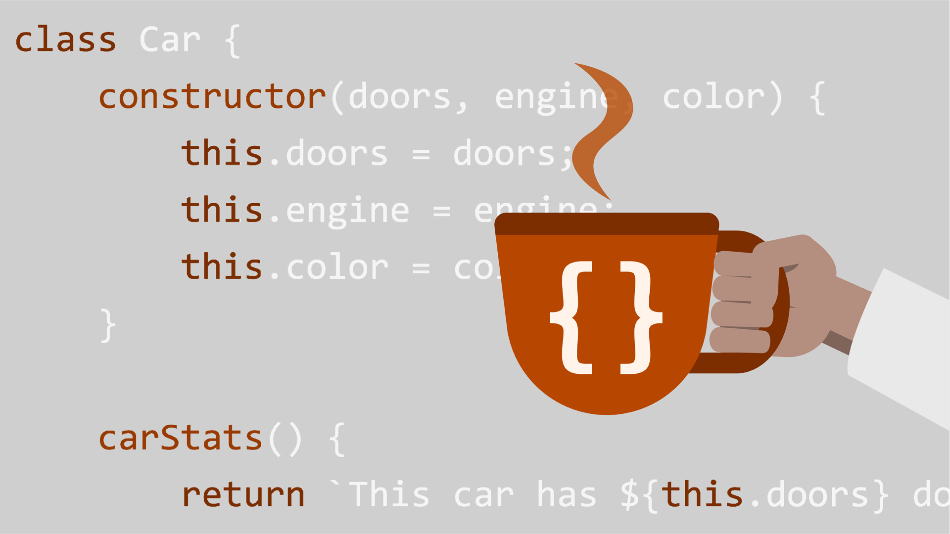
Classes

Slide 4
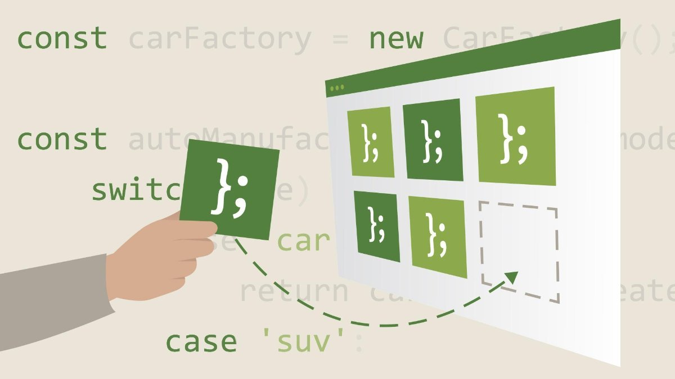
Classes
Classes are “Special Functions”
They have two parts, Class declarations and Class Expressions.

Slide 5
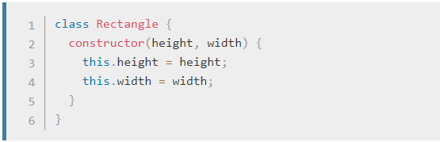
Class Declarations
One way to define a class is using a class declaration. To declare a class, you use the class keyword with the name of the class.
QQ: What is the Class Keyword when looking at this code?

Slide 6
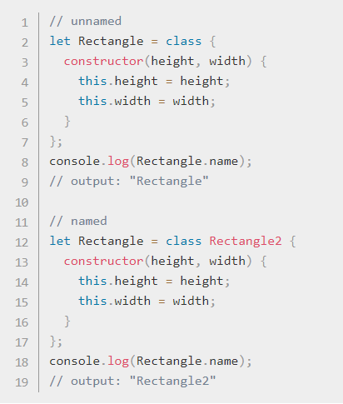
Class Expressions
Class Expressions are another way to define classes.
Class Expressions can be named and unnamed.
You can use unnamed classes internally but not outside of the class.

Slide 7
Purpose of a Class
Classes give functions specific type of behaviors. So, if you have a class that symbolizes a rectangle, you can give that rectangle properties or behaviors using methods.
You can use classes to produce objects of the same type.
You can also use classes to have consistent coding patterns. Classes really help organize like minded code, and give specific properties to certain aspects of your code. You might want to use a class if you want to add multiple properties to a chunk of code, or to an object.
Famous Example: Object: Bank Account Properties: Withdrawal, Deposit, Savings etc.

Slide 8

QQ: Check Your Knowledge
Please put your answers in the chat
When would you want to use a class?
What is the difference between a named class and an unnamed class?
When would you want to use Class Expressions and Class Declarations?

Slide 9
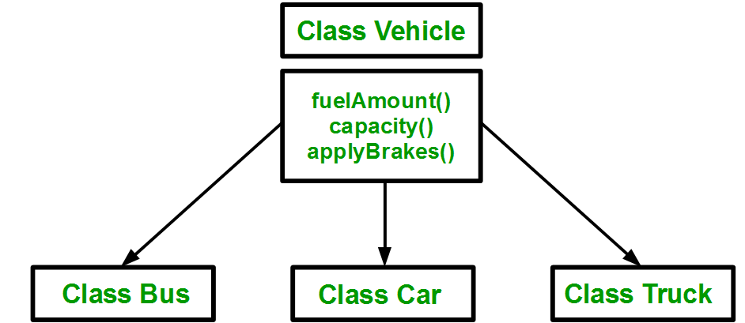
Inheritance

Slide 10

Inheritance
Inheritance allows classes to inherit properties from each other.
For example, if we had a class named animal and another class named Rabbit, because Rabbit is an animal we might want that class to inherit all the properties of animal.
Inheritance shows the relationships between classes and allows them to share properties.

Slide 11
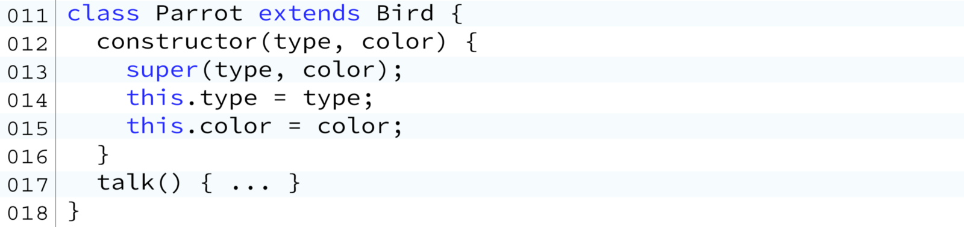
Using the Extend keyword.
Notes:
In order to show that the current class parrot needs to inherit the properties of Bird we would use the keyword extend.
The Keyword extend allows us to pull the propperties of the previous class.

Slide 12
QQ: Check Your Knowledge
Please put your answers in the chat
What is Inheritance?
When do we use Inheritance and what does it do for our code?
How would you use the Extend keyword?

Slide 13
Lets Code

Slide 14


